Slide 1
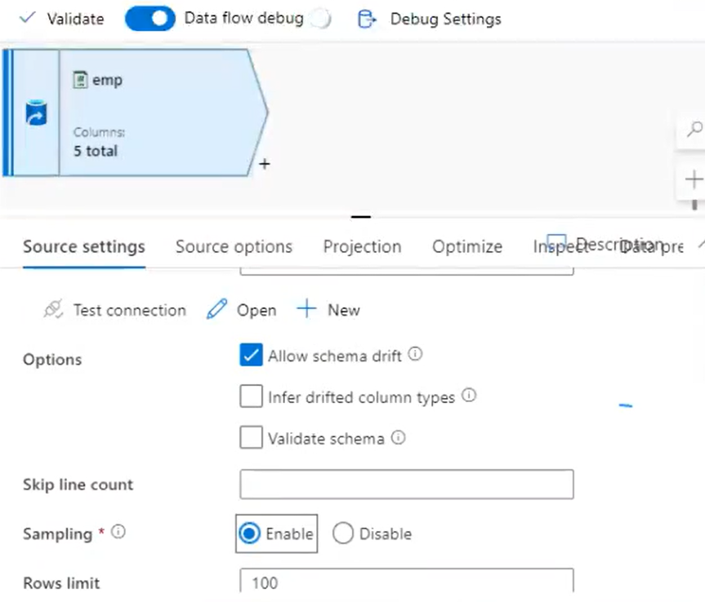
In development mode while working with real time projects enable sampling. Data volume is 1TB and creating data flow for transformation. To check whether transformations are working fine or not, no need work with 1TB of data. In production it will work with 1TB data and in development not required to save cost.

Slide 2
